Slide 1
Stored Procedures
DBMS LAB 10

Slide 2
What is a Stored Procedure?
A stored procedure is a prepared SQL code that you can save, so the code can be reused over and over again.
So if you have an SQL query that you write over and over again, save it as a stored procedure, and then just call it to execute it.
You can also pass parameters to a stored procedure, so that the stored procedure can act based on the parameter value(s) that is passed.

Slide 3
Stored Procedure
A Stored Procedure is a collection of SQL statements (queries) compiled together as a one unit. A Stored Procedure can contain multiple SQL statements such as SELECT, INSERT, UPDATE or DELETE.
they are precompiled thus reduce the overhead of compiling each time

Slide 4
Stored Procedure
Stored Procedures also help in preventing SQL Injections since parameters are used in it.
Other benefits include
Create once and call it N number of times
Reduce traffic since instead of whole query only stored procedure name is sent from front end
A Stored Procedure can be easily modified at a given point of time without modifying any code in the Application.

Slide 5
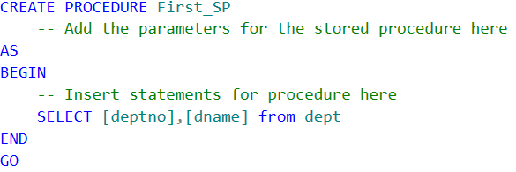
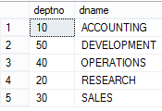
Creating a Stored Procedure
Below figure displays the syntax for creating a stored procedure. As you can see below to create a stored procedure CREATE keyword is used.
exec [dbo].[First_SP]

Slide 6
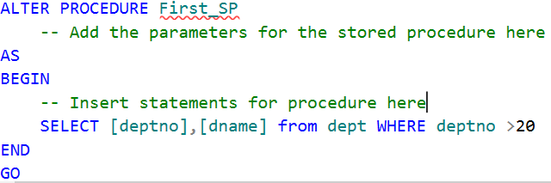

Alter Stored Procedure
exec [dbo].[First_SP]

Slide 7

Drop or Delete a Stored Procedure
Drop procedure [dbo].[First_SP]

Slide 8
Declaring Parameters
Declaring a parameter requires two to four of these pieces of information:
The name
The data type
The default value
The direction

Slide 9

Declaring Parameters
Alter PROCEDURE First_SP
@d_name varchar(14)
AS
BEGIN
SELECT [deptno],[dname] from dept
WHERE dname like '%'+ @d_name
END
exec [dbo].[First_SP] 'ing'

Slide 10
Supplying Default Values
To make a parameter optional, you have to supply a default value.
This looks just like you’re initializing a variable: you just add an = together with the value you want to use for a default after the data type, but before the comma.
Once you’ve done this, the users of your sproc can decide to supply no value for that parameter, or they can provide their own values

Slide 11
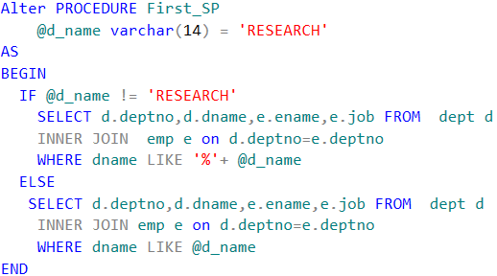
Supplying Default Values

Slide 12
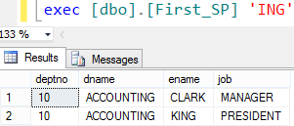
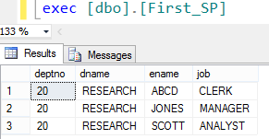
Supplying Default Values
Supplying the value to the required parameter
Given your new default, you can now run the procedure without a parameter

Slide 13
Stored Procedure Syntax
CREATE PROCEDURE procedure_name
AS
sql_statement
GO;

Slide 14
Execute a Stored Procedure
EXEC procedure_name;

Slide 15
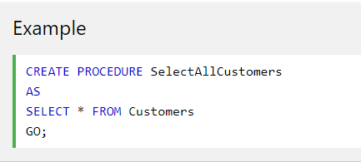
Stored Procedure Example
The following SQL statement creates a stored procedure named "SelectAllCustomers" that selects all records from the "Customers" table:

Slide 16
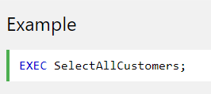
EXAMPLE
Execute the stored procedure above as follows:

Slide 17
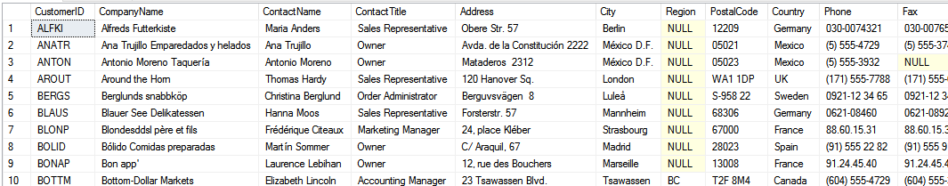
EXAMPLE RESULT

Slide 18
Stored Procedure With One Parameter
The following SQL statement creates a stored procedure that selects Customers from a particular City from the "Customers" table:
CREATE PROCEDURE SelectAllCustomers
@City nvarchar(30)
AS
SELECT * FROM Customers WHERE City = @City
GO

Slide 19
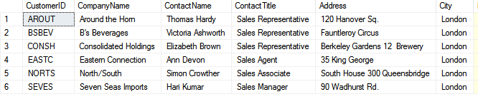
Execute the stored procedure above as follows:
EXEC SelectAllCustomers 'london';

Slide 20
Stored Procedure With Multiple Parameters
Setting up multiple parameters is very easy. Just list each parameter and the data type separated by a comma as shown below.
The following SQL statement creates a stored procedure that selects Customers from a particular City with a particular PostalCode from the "Customers" table:
CREATE PROCEDURE SelectAllCustomers
@City nvarchar(30), @PostalCode nvarchar(10)
AS
SELECT * FROM Customers WHERE City = @City AND PostalCode = @PostalCode
GO

Slide 21
Example
Execute the stored procedure above as follows:
EXEC SelectAllCustomers 'London', 'WA1 1DP';

Slide 22
Changing Stored Procedures with ALTER
The main thing to remember when you edit sprocs with T-SQL is that you are completely replacing the existing sproc. The only differences between using the ALTER PROC statement and the CREATE PROC statement are:
ALTER PROC expects to find an existing sproc, where CREATE doesn’t.
ALTER PROC retains any permissions that have been established for the sproc. It keeps the same object ID within system objects and allows the dependencies to be kept. For example, if procedure A calls procedure B and you drop and re-create procedure B, you no longer see the dependency between the two. If you use ALTER it is all still there.
ALTER PROC retains any dependency information on other objects that may call the sproc being altered.

Slide 23
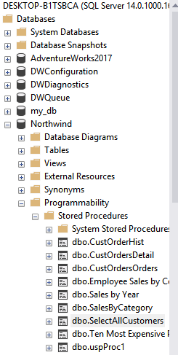
Alter Procedure
To alter the stored procedure, right click it and select Modify that brings the stored procedure in new query window with ALTER statement.

Slide 24
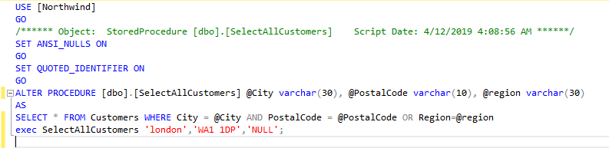
Alter Procedure
Now, alter the stored procedure (altering means addition / deletion / modifying the parameters and its type, altering the SQL statements etc.) and press Execute icon from the toolbar or hit F5 key .
I have changed the datatypes and add one more parameter i.e region.

Slide 25
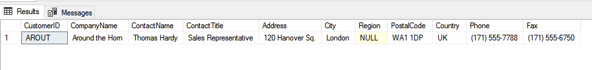
RESULT

Slide 26
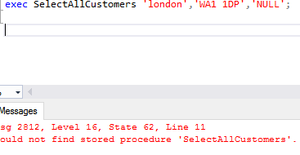

Drop procedure
Dropping Sprocs
It doesn’t get much easier than this:
DROP PROC|PROCEDURE <sproc name>
And it’s gone
Example:
drop proc SelectAllCustomers

Slide 27
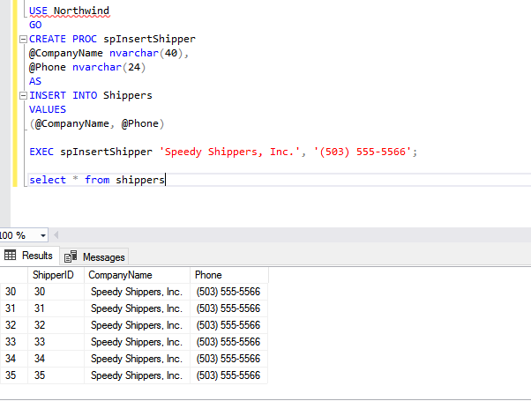
Insert through SP

Slide 28
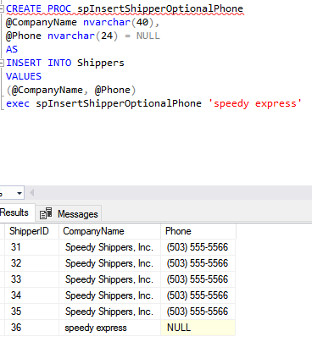
Supplying Default Values

Slide 29
Simple CASE expression
This compares an expression to a set of simple expressions to find the result. This expression compares an expression to the expression in each WHEN clause for equivalency. If the expression with in the WHEN clause is matched, the expression in the THEN clause will be returned.
Syntax
CASE expression
WHEN expression1 THEN Result1
WHEN expression2 THEN Result2
ELSE ResultN
END

Slide 30
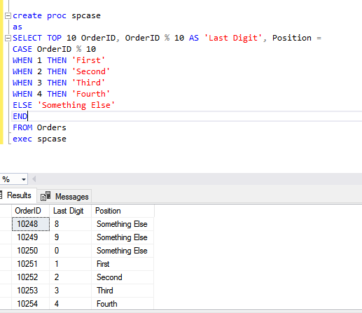
Example - 1

Slide 31
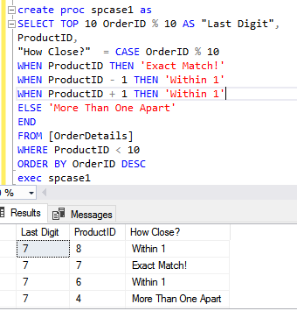
Example - 2

Slide 32
Searched CASE expressions
This expression evaluates a set of Boolean expressions to find the result. This expression allows comparison operators, and logical operators AND/OR with in each Boolean expression.
Syntax
CASE
WHEN Boolean_expression1 THEN Result1
WHEN Boolean_expression2 THEN Result2
ELSE ResultN
END

Slide 33
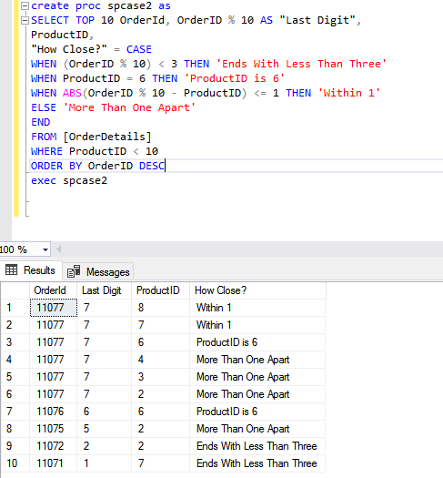
Example - 3

Slide 34
Lab Tasks
Write a simple stored procedure name “CustomerRecord” that
returns the desired Customer record from the Northwind
database given a parameter of the CustomerID.
2. Write a stored procedure name “Territory” that accepts a
Territory ID, Territory Description, and Region ID and inserts
them as new row in the Territories table in Northwind.

